Slide 1
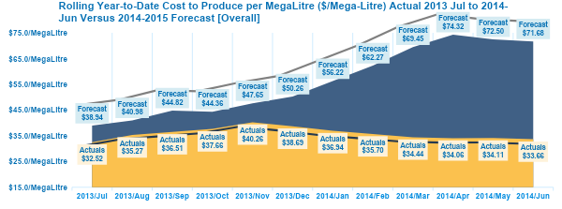
Although water market demand has increased, the outages from these plants is making the production costs and operating expenses to rise, while the revenue is decreasing based on lack of efficiency.
Forecast vs Actual Cost to Produce, YTD, $/Mega-Litres
Key Insights
Revenue
Operating Expenses
Production Costs
Cost to Produce ML
Actual | Forecast
Total Revenue- 787.00M or Δ151% | Total Revenue- 403.30M or Δ51%
Overheads- $ 241.9M or Δ68% | Overheads $ 356.16M or Δ148%
COGS- 9.78M or Δ26% | COGS- 37.37M or Δ382%
$/ML- 35.82 or Δ50% | $/ML- 71.68 or Δ200%

Slide 2
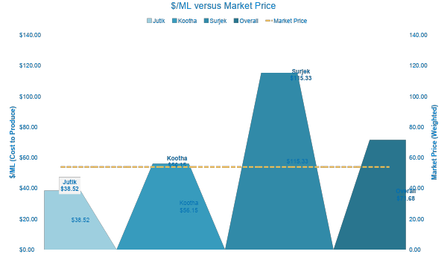
The most efficient desalinated water plant is Jutik, which costs 15.48 $/M/L or 31% profit under the weighted market price. Kootha and Surjek need to be changed unless they go below the market price.
Cost Curve, YTD, $m

Slide 3
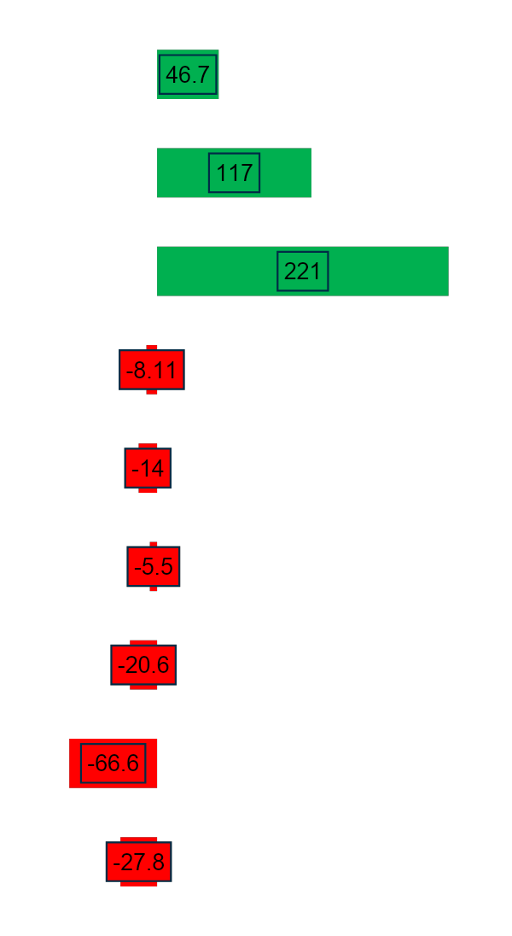
All plants are forecasted to be more expensive and grossing 51% or 383.7M less revenue in the 2014-2015 year. SWC is expected to make 1.8% or 525.55M less than the previous year.
Negative Var.
Positive var.
2013-2014 Actual vs 2014-2015 Forecast EBIT variances, YTD, $m
Actual
Forecast
Revenue
Revenue Kootha
102
55.3
Revenue Surjek
242
125
Revenue Jutik
443
223
COGS
(Production Costs)
COGS Kootha
0.70
8.81
COGS Surjek
7.11
21.1
COGS Jutik
1.97
7.46
Operational Expenses (Overheads)
Operational Expenses Kootha
45.3
65.8
Operational Expenses Surjek
151
217
Operational Expenses Jutik
45.6
73.3
535.32
9.77
¹EBIT
525.55
535.32M
9.77M
¹ EBIT is calculated as Revenues – COGS – Operational Expenses
Source: Financial and operational data from Exemplar
Notes:
Leverage EBIT slide, then flow into Revenue, COGS and Operational Expenses

Slide 4
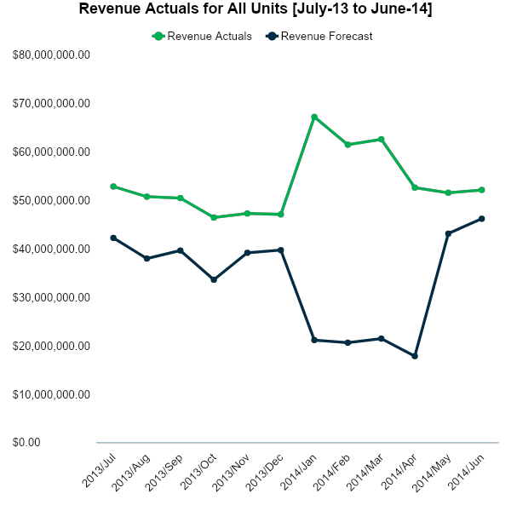
The revenue forecast for the upcoming year 2014-2015 is projected to be 51% or 383.7M lower than the current year of 2013-2014.
Actual vs Budget PL Revenue Analysis, YTD, $m
Key Insights
From January to April, forecasted revenues will be 33% of what they were in 2013-2014.
Kootha revenue from January to April is forecasted to make no revenue during this time.
The Jutik desalination unit is forecasted to make more than Surjek and Kootha combined for the year 2014-2015.
Source: Southern Water Corp Financial Records (SAP) 2013-2015

Slide 5
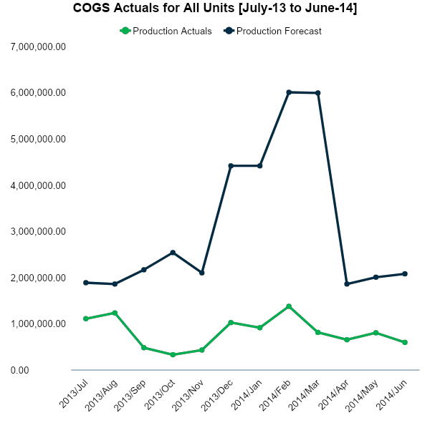
The COGS forecast for the upcoming year 2014-2015 is projected to be 382% or 27.6M higher than the current year of 2013-2014.
Actual vs Budget PL COGS Analysis, YTD, $m
Key Insights
From December to April the forecasted COGS will be up by 474% or 17.9M.
Plant maintenance and plant operational costs drive this value the most during December to April.
The Surjek COGS account for 57% or 21.3M of the COGS for the projected year.
Source: Southern Water Corp Financial Records (SAP) 2013-2015

Slide 6
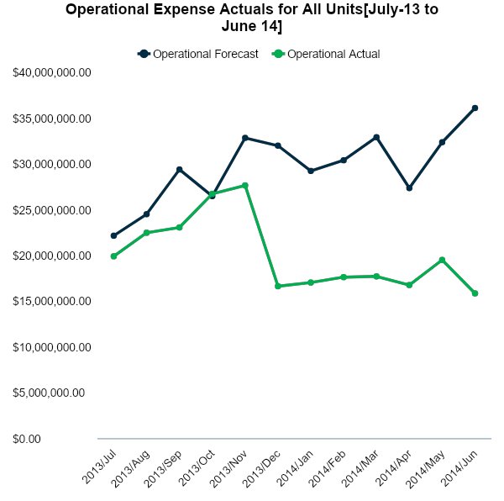
The Operational forecast for the upcoming year 2014-2015 is projected to be 148% higher than the current year of 2013-2014.
Actual vs Budget PL Operational Expenses Analysis, YTD, $m
Key Insights
From December to June there is a 182% or 99.3M increase in expenses.
The Surjek operational expenses account for 61% or 217.2M of the operational costs.
Plant outages account for 16% or 57.0M of all operational expenses.
Source: Southern Water Corp Financial Records (SAP) 2013-2015

Slide 7

The actuals and forecast variance is much greater when the plants are shut down due to pump failure from December to June.
Source: Southern Water Corp Financial Records (SAP) 2013-2015

